Slide 1
Worker’s Time Logger
I/I-SEM/YEAR Mini Project
Anup Kafle
Sudip Shrestha
Sanish Shrestha
Rochak Sedai
075-BCT-11
075-BCT-46
075-BCT-41
075-BCT-30

Slide 2
Overview
Introduction
Objectives
Target Audience
Literature Review
Models and Project Management
Tools and Platforms
Expected Results

Slide 3
Introduction

Slide 4
A program in C to view worker’s details.
It peforms the employee management(edit,add,view,search etc)

Slide 5
Objectives

Slide 6
To store the data of Workers
To delete or add the data
To search the data
To view the salary of a worker according to time

Slide 7
Target Audience

Slide 8


Worker’s time Logger
Math H/W Submission
Science test
Our first approach is for bussinessmen to manage their employee basic information in systematic way.

Slide 9
Literature Review

Slide 10
- Workers Time Logger as found as previous development - Coding done using Case statement , file pointer , structures etc with reference from textbook( )

Slide 11
Salary Calculation
1 hr: Rs.200
1 min: Rs.3.33

Slide 12
Models &
Project Management

Slide 13
Append
Add data to existing File
Search
Search Data from existing File.
Menu
Delete
Delete the existing data.
Modify
Modify the existing data
Display
Display the specific data of employee
Display All
Display all stored data
Exit
Exits the program

Slide 14
Add detail
Search Employee
Database File
List Employee

Slide 15
 | 1 | 2 | 3 | 4 | 5 | 6 | 7 | 8
Collecting Requirements
System Design
Coding and Development
Testing and Debugging
Documentation
 | Anup |  | Sanish |  | Sudip |  | Rochak All

Slide 16
Tools & Platforms

Slide 17
Sublime Text Editor
Atom Text Editor
cross-platform source code editor
free and open-source text and source code editor
Windows
CodeBlocks IDE
Git
version control system for tracking changes in computer files and coordinating work
open-source cross-platform IDE that supports multiple compilers

Slide 18
Expected Results

Slide 19
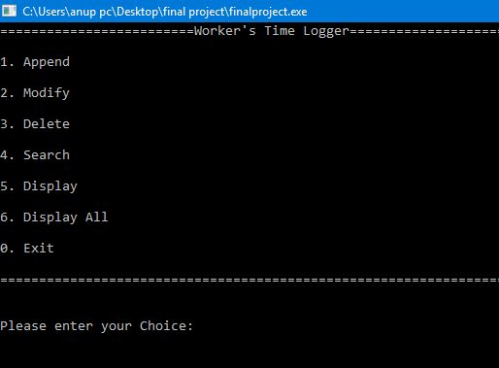
Output
Our program can perform following Task:
Read Employee data.
Modify/Edit the existing data.
Search Employee data by Name/Id No.
Display and calculate salary of Employee.
Display all information of all Employee

Slide 20
Thank You!
Any Queries?

